Slide 1
Games Bootcamp
Distribution & Publishing

Slide 2
Recap
Monetisation

Slide 3
Table of contents
01
Distribution
02
Publishing
03
Launch Strategies

Slide 4
01
Distribution

Slide 5
The process of delivering games to consumers

Slide 6
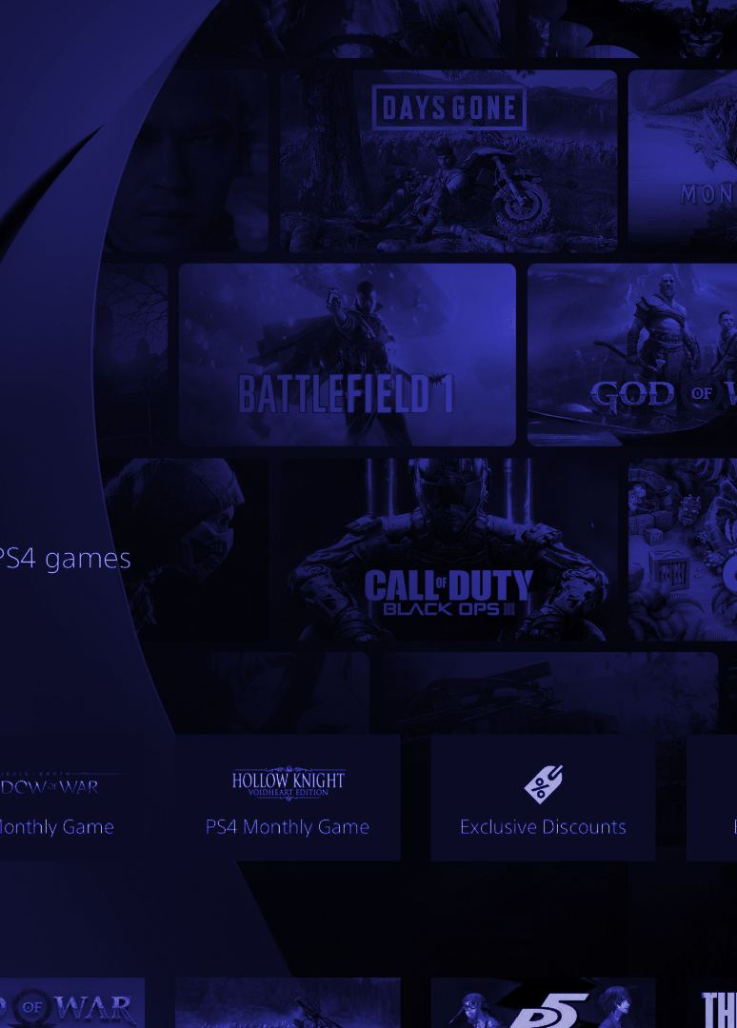
Distribution (1)
Digital Accessibility: digital distribution ensures global reach without the constraints of physical logistics.
Cross-Platform Availability: Extends the presence across multiple platforms, crucial for maximizing player base.
Revenue Streams: creates potential for initial sales, in-game purchases, and subscriptions.
Long-Tail Sales Potential: Games can continue to generate revenue long after initial release through updates and expansions.
Compared to Other Media: Gaming stands out with the ability to update and evolve content post-release, while most other media is static after launch.

Slide 7
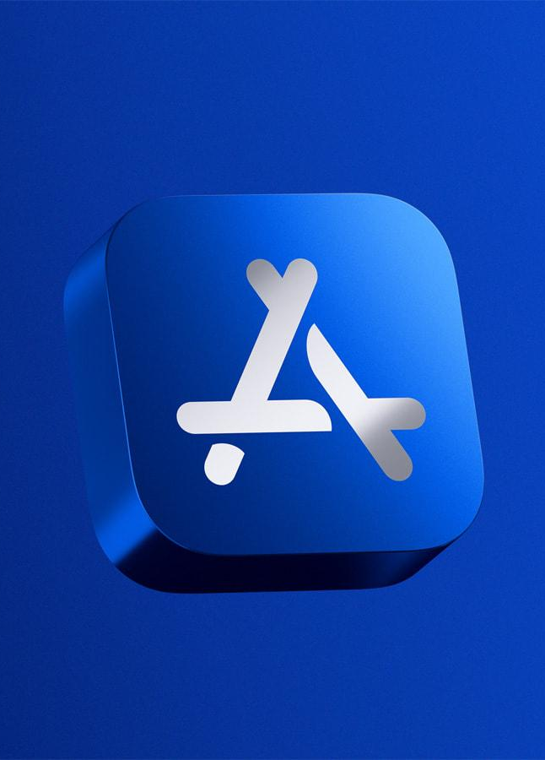
Distribution (2)
Google Play Store | Apple App Store
Pros:
Wide Reach: Access to a global audience through platforms like Apple App Store and Google Play.
Ease of Access: integrated payment systems for users.
Analytics: Direct insights through ratings and reviews.
Cons:
Market Saturation: High competition can make app visibility and user acquisition challenging.
Revenue Share: App stores typically take a cut of revenue 15-30%. (first $1m)
Strict Guidelines: Must adhere to specific platform rules and approval processes which can be stringent.

Slide 8
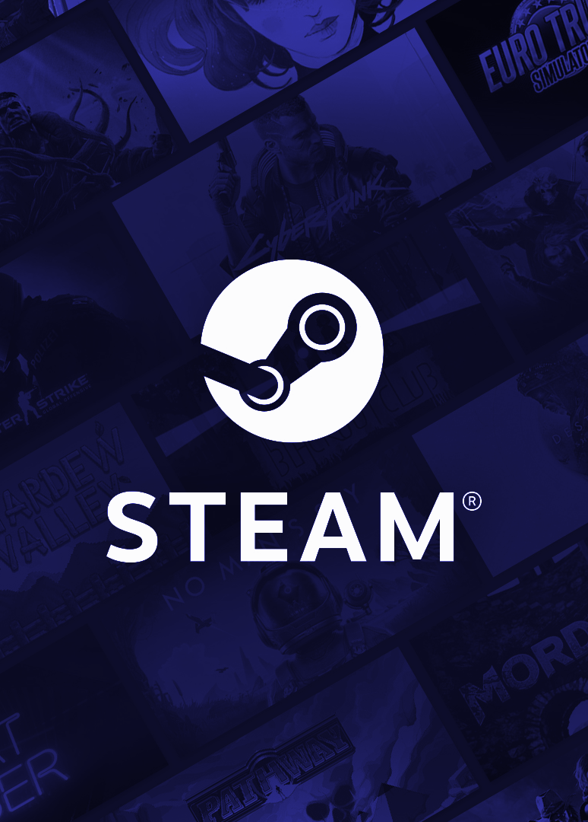
Distribution (3)
Digital Storefront
Pros:
Diverse Audience: platforms like Steam, Epic Games store cater to various niches and genres
Community Features: built-in forums, mod support and social features
Sales and promotions: opportunities for flash sales, discounts and bundling.
Cons:
Algorithms: discovery often favours established publishers
Integration Requirements: Need to integrate with each storefront SDK.

Slide 9
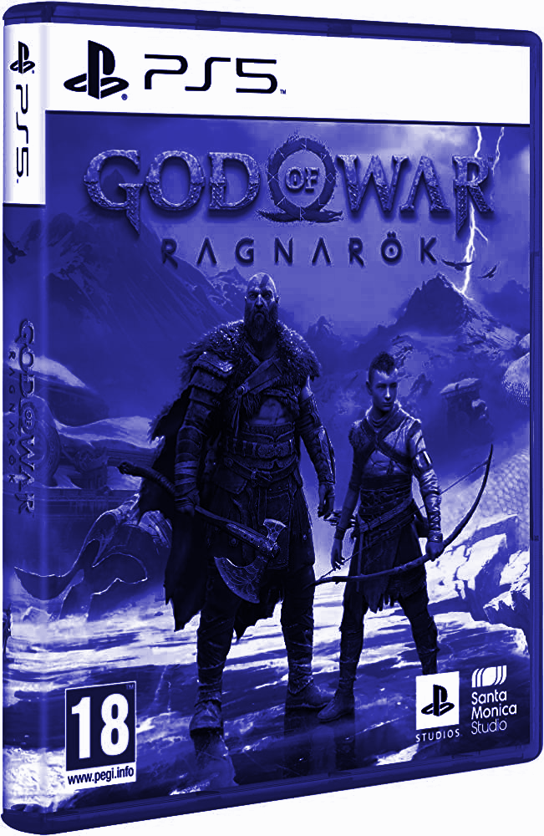
Distribution (4)
Physical Distribution
Pros:
Tangible Product: can be attractive to niche audiences (collector’s editions etc)
Infrastructure: while increasingly less of a factor, physical games are still more favourable where internet infrastructure is not reliable.
Console Deals: publishing deals are struck with Sony/Microsoft for these deals
Cons:
Higher costs: manufacturing, shipping and inventory increase overhead
Obsoletion ?

Slide 10
02
Publishing

Slide 11
Publishing involves the financing, marketing, and broader management of a game's release

Slide 12

Publishing (1)
Traditional Game Publishers:
Pros: With their extensive network and capital, they can transform a good game into a global sensation.
Cons: They often want a large piece of the pie and might steer the game direction to ensure profitability.
Indie Game Publishers:
Pros: More lenient and supportive of indie developers, allowing for innovation and uniqueness.
Cons: Limited resources can mean the game might not get the same level of exposure
Self-Publishing:
Pros: full ownership of IP and revenue
Cons: The onus of marketing, distribution, and feedback collection lies entirely on the developer.

Slide 13
Publishing (2)
Publishing agreements serve as the foundational document upon which a developer's relationship with a publisher is built. It sets the terms of their professional partnership and outlines the roles, responsibilities, and expectations of both parties.
IP (Intellectual Property) Ownership:
Ownership determines who has the right to make sequels, merchandise, or adaptations Sometimes publishers want a share or full control, especially if they believe the game can become a franchise.
Monetization Strategies:
This defines how the game will earn revenue. Monetization affects game design. For instance, freemium games might need in-game stores and mechanics that encourage in-app purchases. developers need to ensure that monetization strategies align with their vision for the game.
Development Milestones:
These are specific targets set throughout the development process, like alpha or beta releases, bug fixing, or content addition. Meeting milestones usually triggers payments from publishers to developers. Missing them could lead to penalties or strained relations.
Notes:
There is a unity package but we will be making a basic solution to understand how the process would work.

Slide 14
Publishing (3)
Termination Clauses:
Breach of contract
Bankruptcy
Mutual Agreement
Force Majeure
Prerequisite:
Develop a prototype: playable version of a game
Press Kit: screenshots, videos, clear description.
Clear Sales Pitch: Target Audience, Competitors, Analytics, Projections.
Pitch:
Research: find publishers that align with your game genre and style
Elevator Pitch: Create a short impactful description of your game
Clear Monetisation strategy: you should have already established Ads & IAPs
Closing the deal:
Initial Contact: Game Events, email and connections!
Presentation: They will playtest your game, they’re not expecting perfection but standards are high
Read The Fine Print: a lawyer who specialises in game publishing may not be realistic.
Notes:
There is a unity package but we will be making a basic solution to understand how the process would work.

Slide 15
03
Launch Strategies

Slide 16
Launch Strategies (1)
Soft Launch:
Aims to gather real-world data
Games are soft-launched in countries that mirror the behaviors of larger markets but have a smaller user base.
This can include countries like New Zealand, Canada, or regions in Scandinavia.
Developers can experiment with monetisation
Global Launch:
A large-scale release aimed at capturing the broadest audience possible.
Game should be polished, with all major bugs addressed and features tested.
Requires a substantial marketing budget and coordination across various channels.
Notes:
There is a unity package but we will be making a basic solution to understand how the process would work.

Slide 17
Launch Strategies (2)
Launch Events:
In-Game Events: Special challenges, limited-time rewards, or thematic content can attract players during the launch phase.
Influencer Collaborations: Teaming up with gaming influencers for live streams, reviews, or promotional events.
Physical Events:
Hosting launch parties, participating in gaming conventions, or creating pop-up.
Indie developers can benefit from showcasing their game at local gaming events or conventions.
Post-Launch Support:
Player Communication: Developers should actively engage with reviews and forums.
Regular Updates:
Prompt and regular bug fixes
New levels, characters & modes
Seasonal or Thematic Events:
These can align with real-world events or holidays,
Feedback Integration:
Utilizing player feedback for game improvements shows that the developers are responsive and care about the player experience. This can foster loyalty and encourage long-term engagement.
Notes:
There is a unity package but we will be making a basic solution to understand how the process would work.

Slide 18
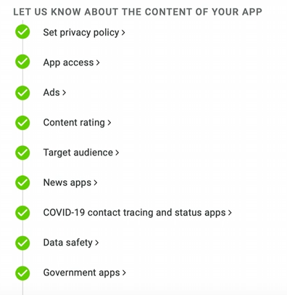
Launch Strategies (3)
Publishing to the App Stores.
Google Play:
Sign up for a Google Play Developer account at the Google Play Console.
Pay the one-time registration fee required by Google to create your account. ($25)
Accept the Google Play Developer Distribution Agreement.
Apple Developer Program:
Sign up for an account at the Apple Developer Program.
There is an annual fee to be able to publish to the App Store. ($99)
Accept Apples Agreement

Slide 19
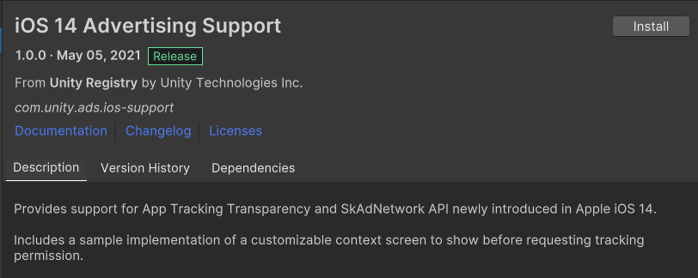
Launch Strategies (4)
Strict Guidelines & Data Protection
Both platforms have guidelines that if unfollowed will have your game removed and possibly your account banned
These mainly revolve around a working product and data protection

Slide 20
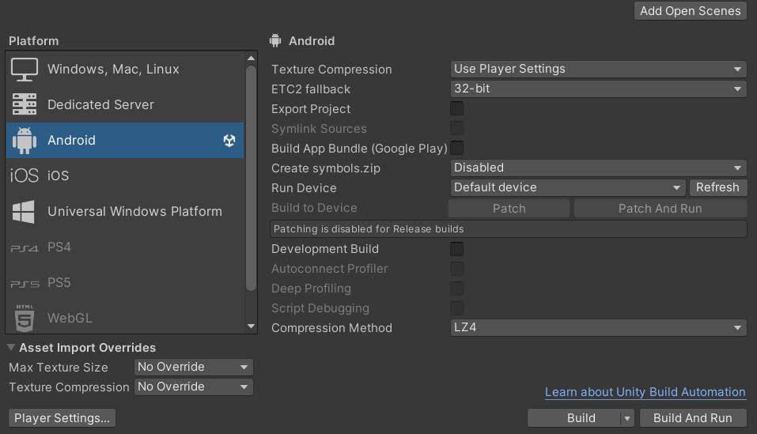
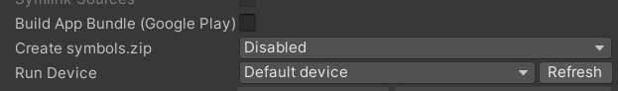
Launch Strategies (5)
Build Settings (Android)
File -> Build Settings.
From this window you can choose the platform that you want to create a Build for.
You can connect to a device through USB or WIFI as well as create a DEV build for debugging
When building for android unity will create an .apk file. This can be transferred and installed on any android device as long as external sources are enabled (DEVELOPER SETTINGS)
When building for the Play Store, tick the app bundle option which will create an .aab file that can be uploaded to the Google play console

Slide 21
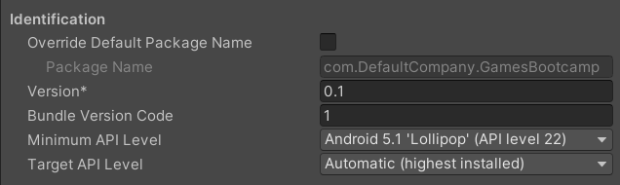
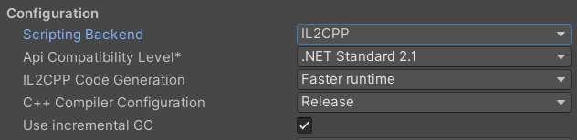
Launch Strategies (5)
Player Settings (Android)
File -> Build Settings -> Player Settings.
This window allows us to set various publishing settings
Once we setup our app in the browser we will need to override the package name under Other Settings and set the min API level to 32
You will also need to set the Scripting backend to use IL2CPP

Slide 22
Thanks!

